Slide 1
DISCRETE MATHEMATICS PROJECT
SUBMITTED BY:
AHMAD SAJJAD (2023-CS-81)
ABDUL-REHMAN (2023-CS-73)

Slide 2
CONTENT
GRAPH THEORY
NUMBER THEORY

Slide 3
INDIVIDUAL CONTRIBUTION and project planning:
Individual Contribution:
The coding problems of number theory and slides for presentation were made by AHMAD SAJJAD (2023-CS-81).
The theoretical questions and coding problems of graph theory were made by ABDUL-REHAMN (2023-CS-73).
PROJECT PLANNING:
In project planning first divided the whole project into two parts number theory and graph theory. And then we decided both will do one part each. For coding problems we choose c++ language as in 1st semester we used that c++ very much. And for games section we studied those games which we had played and knew that graph is used in this game.

Slide 4
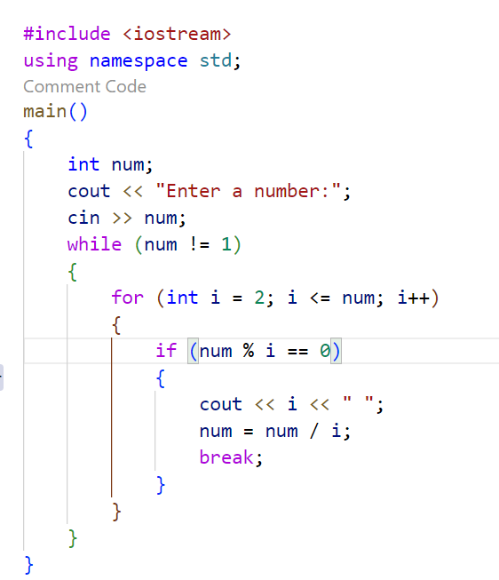
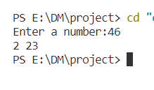
NUMBER THEORY
PROBLEM # 1(PRIME FACTORIZATION):
RESULT:
(APPROACH USED):
Used two loops one while and one for loop which will search for the odd prime numbers and will display all of them.

Slide 5
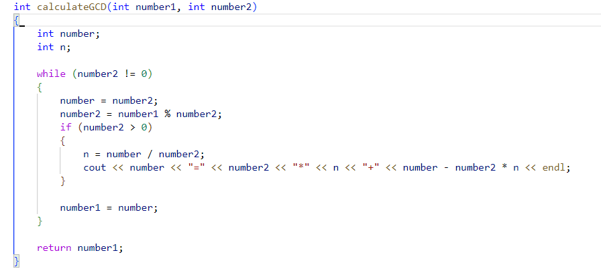
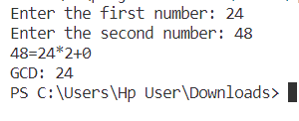
NUMBER THEORY
PROBLEM # 2(GCD USING EUCLIDEAN ALGORITHM):
RESULT:
(APPROACH USED):
In this program I have write a function which will calculate the GCD and print all the steps of gcd until the number 2 becomes 0.

Slide 6
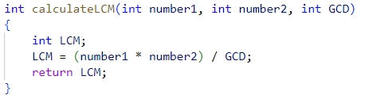
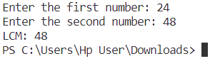
NUMBER THEORY
PROBLEM # 3(LCM):
RESULT:
(APPROACH USED):
In this program I have used the GCD program to calculate the lcm as you know that we can find lcm by using gcd.
lcm = (n1*n2)/GCD(n1,n2)

Slide 7
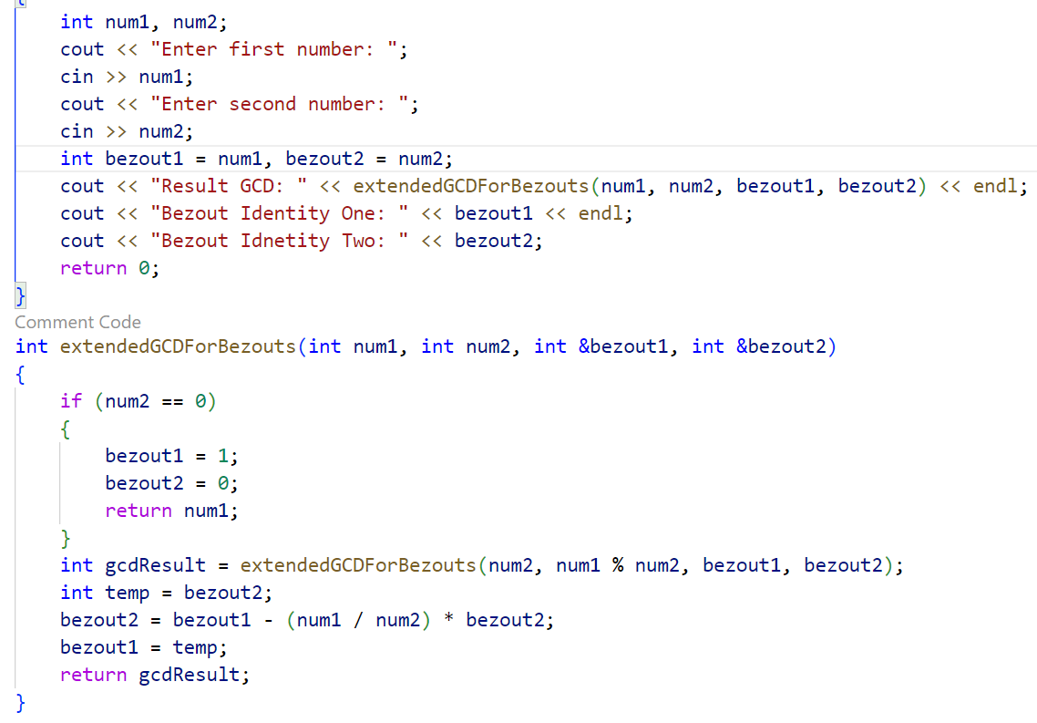
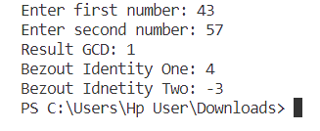
NUMBER THEORY
PROBLEM # 4(BEZOUT COEFFICIENTS):
RESULT:
(APPROACH USED):
In this program I have write a function which will find the bezout coefficients by recursive calls of gcd function and then applied the bubble sort algorithm to swap the coefficients into correct variables.

Slide 8
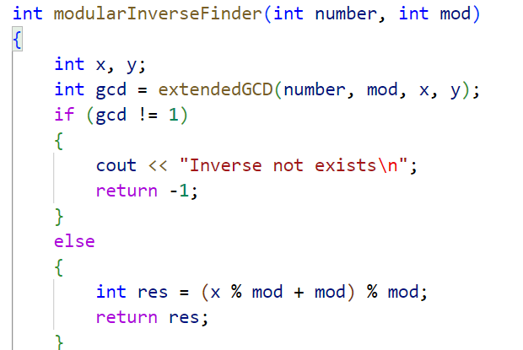
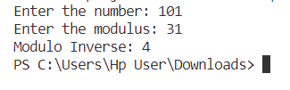
NUMBER THEORY
(APPROACH USED):
In this program I have write a function which will first find the gcd and if the gcd is not 1 then the inverse does not exist if gcd is other than 1 then it applies the result formula to and calculate the inverse.
PROBLEM # 5(INVERSE):
RESULT:

Slide 9
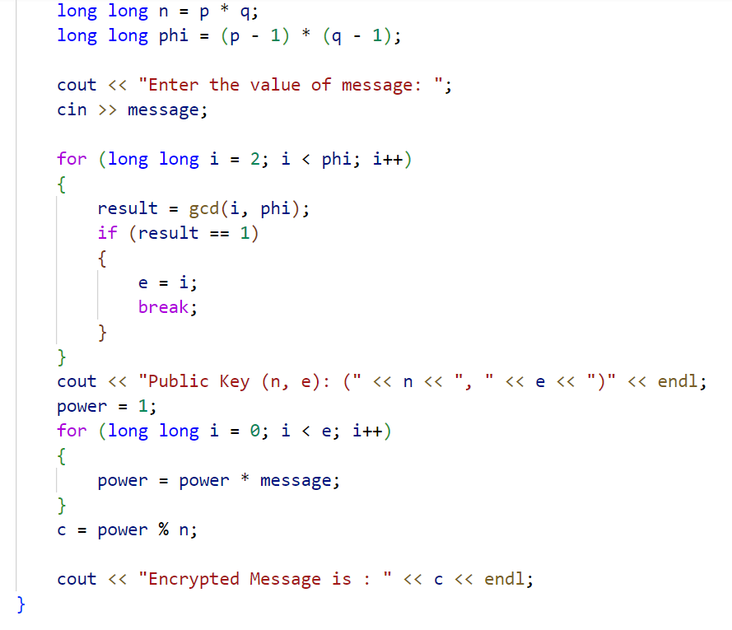
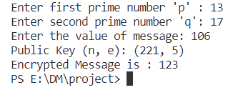
NUMBER THEORY
PROBLEM # 6(RSA ENCRYPTION):
RESULT:
(APPROACH USED):
In this program I have first find the n and phi value and then by using a loop I have find the value of e then used that value in the encryption formula to find the encrypted message.

Slide 10
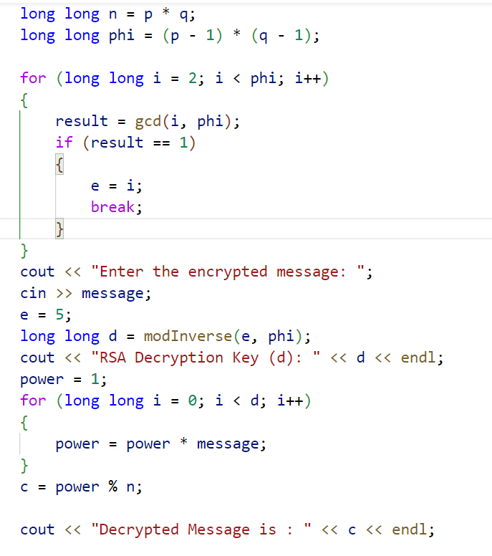
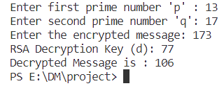
NUMBER THEORY
(APPROACH USED):
In this program I have first find the n and phi value and then by using a loop I have find the value of e then used that value in the encryption formula to find the encrypted message then by using the inverse method found the value of d which is the decryption key then used the formula of decryption to find the original value.
PROBLEM # 7(RSA DECRYPTION):
RESULT:

Slide 11
SPECIAL THANKS!
TO SIR WAQAS ALI FOR GIVING US THIS OPPORTUNITY!

